Slide 1


Slide 2
What is a Project?
Project
  A project is a temporary endeavor undertaken to create a unique product, service, or result.
  A complex, nonroutine, one-time effort limited by time, budget, resources, and performance specifications designed to meet customer needs.
1–<number>

Slide 3
What is a Project?
Major Characteristics of a Project
  Has an established objective.
  Has a defined life span with a beginning and an end.
  Requires across-the-organizational participation.
  Involves doing something never been done before.
  Has specific time, cost, and performance requirements.
1–<number>

Slide 4
What a Project is not?
  Project should not be confused with everyday work.
  A project is not a routine, repetitive work.
  Ordinary work typically requires doing the same work over and over.
  While a project is done only once.
1–<number>

Slide 5
Programs versus Projects
Program Defined
  A series of coordinated, related, multiple projects that continue over an extended time and are intended to achieve a goal.
  (Goal is the long term direction of company, where a company wants to be?
  Objective is small steps in order to achieve the goal.)
  A higher level group of projects targeted
  at a common goal.
  Each project within a program has a project manager.
  The major differences lie in scale and time span.
1–<number>

Slide 6
Programs versus Projects
Program Management
  Program management is the process of managing a group of ongoing, interdependent, related projects in a coordinated way to achieve strategic objectives.
  Example:
    Project: completion of a required course
    in project management.
    Program: completion of all courses required
    for a business major.
1–<number>

Slide 7
Comparison of Routine Work with Projects
Routine, Repetitive Work
Taking class notes
Daily entering sales receipts into the accounting ledger
Responding to a supply-chain request
Practicing scales on the piano
Routine manufacture of an Apple iPod
Attaching tags on a manufactured product
Projects
Writing a term paper
Setting up a sales kiosk for a professional accounting meeting
Developing a supply-chain information system
Writing a new piano piece
Designing an iPod that is approximately 2 X 4 inches, interfaces with PC, and
stores 10,000 songs
Wire-tag projects for GE and
Wal-Mart
TABLE 1.1
1–<number>

Slide 8
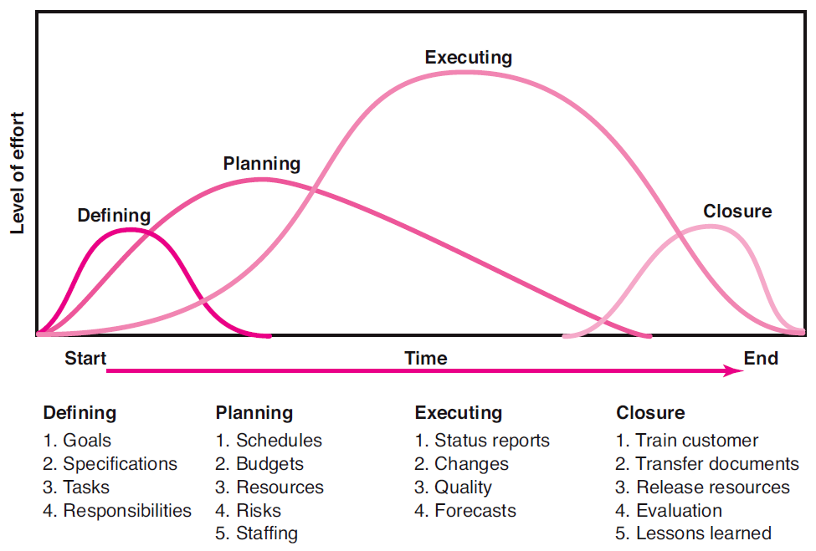
Project Life Cycle
FIGURE 1.1
1–<number>

Slide 9
Project Life Cycle
1- Defining Stage:
Specifications of the project are defined; project objectives are established; teams are formed; major responsibilities are assigned.
2- Planning Stage:
The level of effort increases, and plans are developed to determine what the project will entail (include), when it will be scheduled, whom it will benefit, what quality level should be maintained, and what the budget will be.
FIGURE 1.1
1–<number>

Slide 10
Project Life Cycle
3- Executing Stage:
A major portion of the project work takes place – both mental and physical.
The physical product is produced ( a bridge, a report, a software program).
Time, cost and specification measures are used for control.
Is the project on schedule; on budget and meeting specifications?
What are the major forecasts?
What revision/changes are necessary?
FIGURE 1.1
1–<number>

Slide 11
Project Life Cycle
4- Closure Stage:
It includes three activities:
Delivering the project product to customers (includes customer training and transferring documents).
Redeploying project resources (involves releasing project equipment/materials to other projects, finding new assignments for team members).
Post-project reviews (include not only assessing performance but also capturing lessons learned).
FIGURE 1.1
1–<number>

Slide 12
The Challenge of Project Management
Project management is the application of knowledge, skills, tools, and techniques to project activities to meet the project requirements
The Project Manager
  Manages temporary, non-repetitive activities and frequently acts independently of the formal organization.
    Manage resources for the project.
    Is linked directly to the customer interface.
    Provides direction, coordination, and integration
    to the project team.
    Is responsible for performance and success of the project.
  Must induce/persuade the right people at the right time to address the right issues and make the right decisions.
1–<number>

Slide 13

The Importance of Project Management
Factors leading to the increased use of project management (a standard way of doing business).
  Compression of the product life cycle
  Knowledge explosion
  Triple bottom line (planet, people, profit)
  Corporate downsizing
  Increased customer focus
  Small projects represent big problems
1–<number>
Notes:
3

Slide 14
Benefits of an Integrative Approach
to Project Management
Competing in a global market influenced by rapid change, innovation and time to market which means organizations manage more and more projects.
Means for coordinating and managing project ?
  Centralization (integration) of project management processes has been the practical outcome.
1–<number>

Slide 15
Benefits of an Integrative Approach
to Project Management
The rationale for integration of project management was to provide senior management with:
  An overview of all project management activities
  A big picture of how organizational resources are used
  A risk assessment of their portfolio of projects
  A rough metric of the firm’s improvement in managing projects relative to others in the industry
  Linkages of senior management with actual project execution management
1–<number>

Slide 16
Benefits of an Integrative Approach
to Project Management
Integration (or centralization)
  enables management to have greater flexibility and better control.
  applying a set of knowledge, skills, tools, and techniques to a collection of projects in order to move the organization towards its goals.
  represents a major thrust of project driven organizations across all industries.
1–<number>

Slide 17
Integrated Project Management Systems
Problems resulting from the use of piecemeal project management systems:
  Do not tie together the overall strategies of the firm.
  Fail to prioritize selection of projects by their importance of their contribution to the firm.
  Are not integrated throughout the project life cycle.
  Do not match project planning and controls with organizational culture to make appropriate adjustments in support of project endeavors.
1–<number>

Slide 18
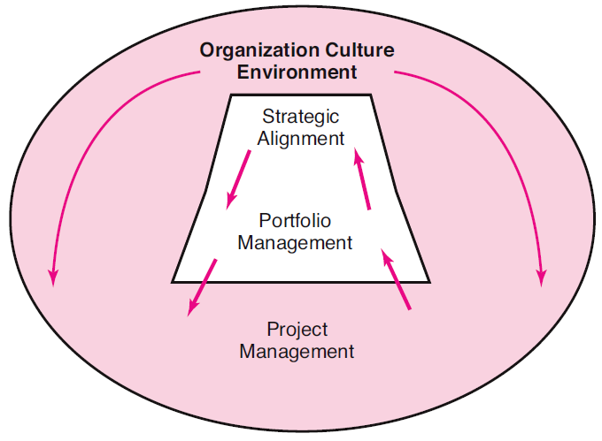
Integrated Management of Projects
FIGURE 1.2
1–<number>

Slide 19
Integration of Projects with Organizational Strategy
Ensuring strategic alignment requires a selection process that is systematic, open, consistent, and balanced.
All of the projects selected become part of a project portfolio that balances the total risk of the organization.
Management of the project portfolio ensures that only the most valuable projects are approved and managed across the entire organization.
1–<number>

Slide 20
Integration of Projects Through Portfolio Management
Major Functions of Portfolio Management
Oversee project selection.
Monitor aggregate resource levels and skills.
Encourage use of best practices.
Balance projects in the portfolio in order to represent a risk level appropriate to the organization.
Improve communication among all stakeholders.
Create a total organization perspective.
Improve overall management of projects over time.
1–<number>

Slide 21
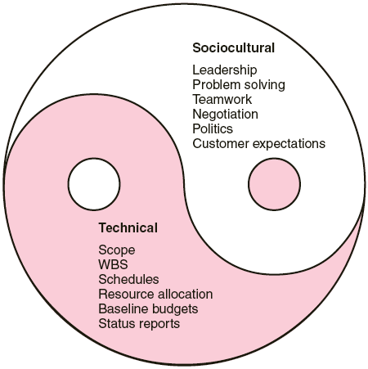
The Technical
and Sociocultural Dimensions
of the Project Management Process
FIGURE 1.3
1–<number>

Slide 22
Integration of the Processes of Implementing Actual Projects
Technical side of the management process:
  Consists of the formal, disciplined, purely logical parts of the process.
  Includes planning, scheduling, and controlling projects.
  Clearly defined scope statements.
  Work breakdown structures serves as database to link all levels in the organization.
  Efficient resource allocation and status reports.
1–<number>

Slide 23
Integration of the Processes of Implementing Actual Projects
Sociocultural side of the management process:
  creates a temporary social system within an organization to combine the talents of a divergent set of professionals.
  shape a project culture that stimulates teamwork and motivation to solve a problem.
  maintain customers’ expectations, sustain the political support of top management, negotiate and build a cooperative social network.
1–<number>

Slide 24
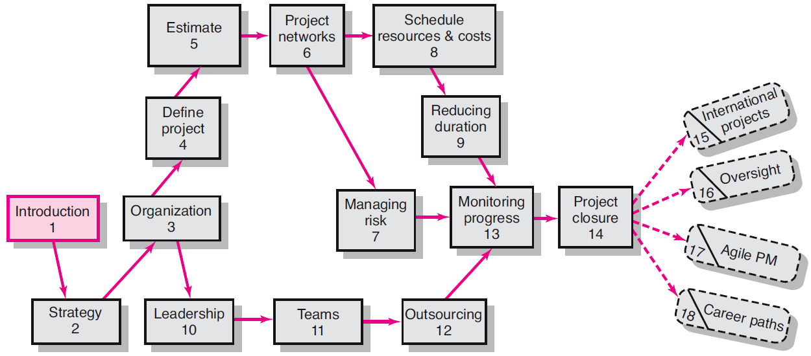
An Overview of Project Management 5e.
1–<number>

Slide 25
Key Terms
ISO 9000
Program
Project
Project life cycle
Project Management Professional (PMP)
Sociotechnical perspective
1–<number>

